Slide 1
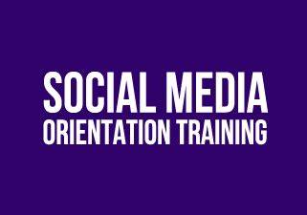

Marketing Team Training Manual
How to use Social Media to promote a product/service for your company.

Slide 2
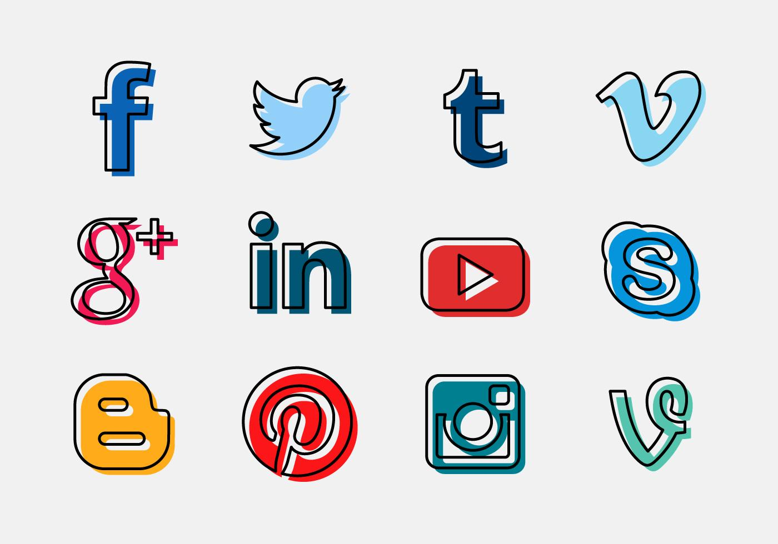
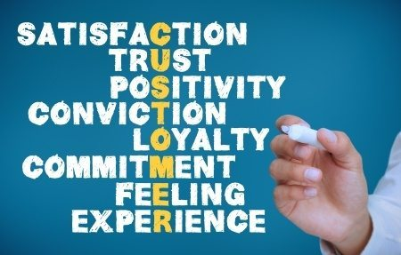
Multiple outlets to promote, which leads to diverse groups of people
Why should you as a marketing teams use social media?
Brings loyal customers because of they see the true brand.

Slide 3

Why should you as a marketing teams use social media?
FREE promoting
Shows that you can compete with brands.

Slide 4

Steps to gain velocity on social media to promote a product or service.
Next couple slides will how Wendy’s takes a chance to promote their product on a social media site like Twitter. Take note from the example.

Slide 5
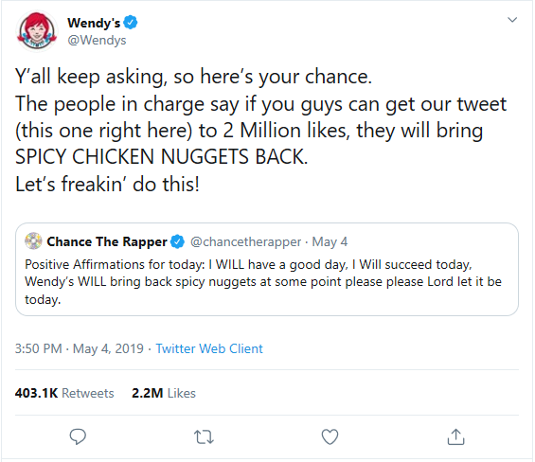
1st Step
Wendy’s promoted their spicy chicken nuggets by to responding to a celebrity on twitter who had a pre-existing following.
By having Chance the Rapper tweet about spicy chicken nuggets. By tweeting with Chance the Rapper Wendy’s was able to easily gain velocity.

Slide 6
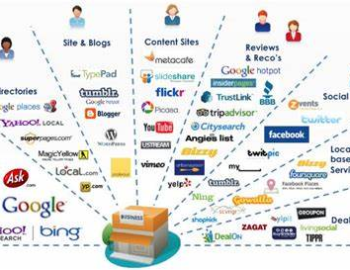
2nd Step
Wendy’s responded by telling the media that the company would bring the spicy nuggets back it they received 2 million likes on the tweet.
By Wendy’s telling twitter users that if the tweet got 2 million like they would bring back spicy chicken nuggets. It immediately gain velocity and free marketing.

Slide 7
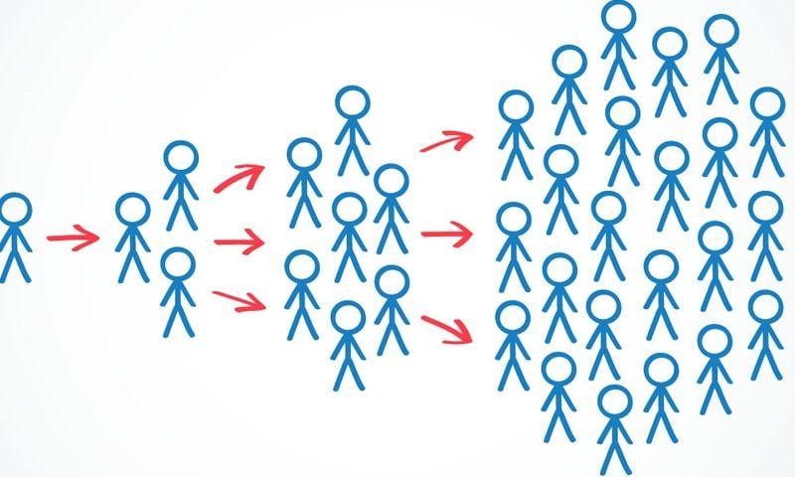
3rd Step
During and after Wendy’s made the challenge, the marketing team was 24/7 working to respond to regular twitter users to keep the velocity going up about the nuggets.
When marketing a product, as a marketing team, you should be focused on keeping that topic on trend to gain as much velocity as you can. Wendy’s was able to keep replying to user. The marketing team was able to make to replies funny to have fun with the supporters, which made it go more viral.

Slide 8
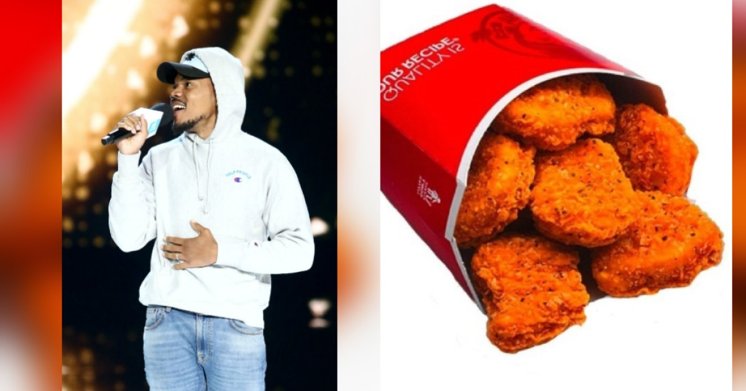
4th Step
Announced the release date of the nuggets. While promoting across all social media that they are coming back.
When Wendy’s tweet reach 2 million likes the company spread the word across all social media platforms to promote the nuggets coming back. Not only was Twitter involved in bringing back the spicy nuggets, but the different outlets over the internet. Once the internet notice immediately that Chance the Rapper and Wendy’s was tweeting it sparked, news channels and social media feed.

Slide 9
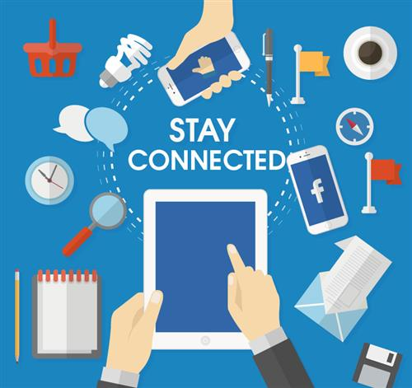
5th Step
Stay connected and up to date on product/services.
Wendy’s stayed up to date by still replying to users on twitter for multiple months after the tweet went viral. Wendy’s made sure that supporters new that the product was stil being talked about and made sure the product was being promoted through social media sites.

Slide 10
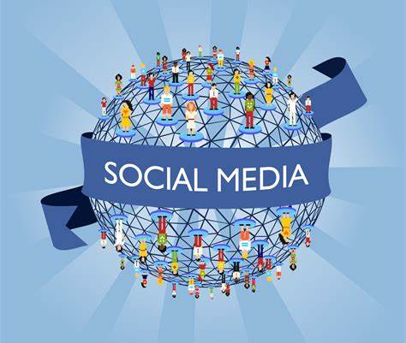
Will you be able to use Social Media to promote a product/service within your company.
Social Media is the way of todays marketing. Use the media, stay connected, and build your brands image with only using technology.

