Slide 1
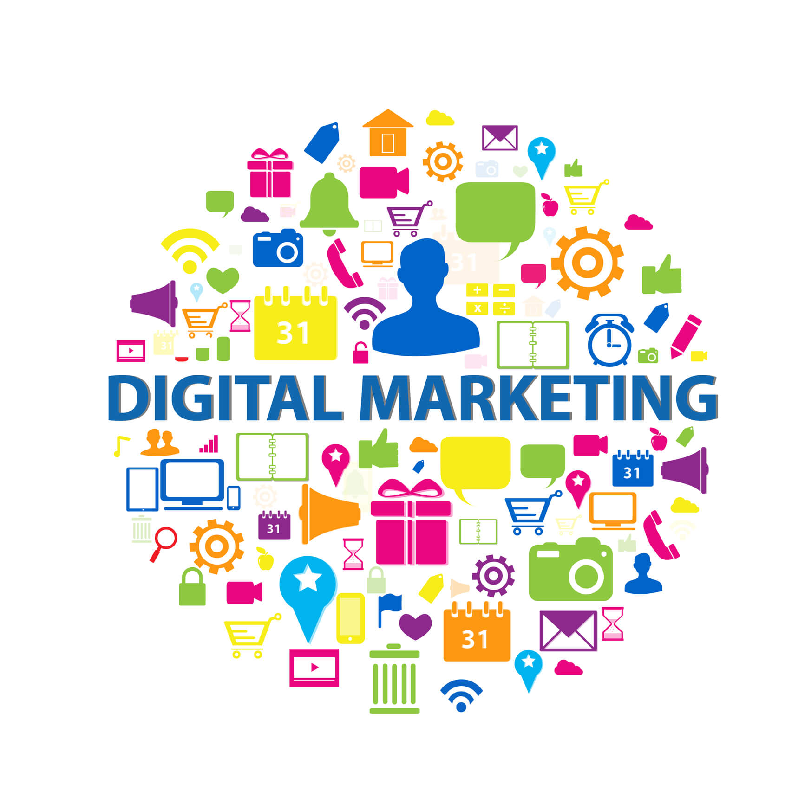
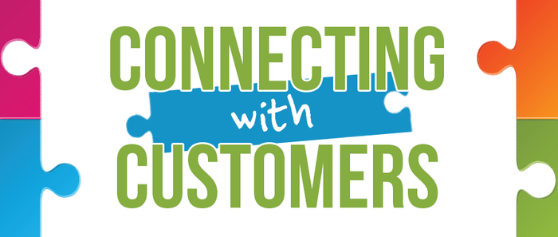
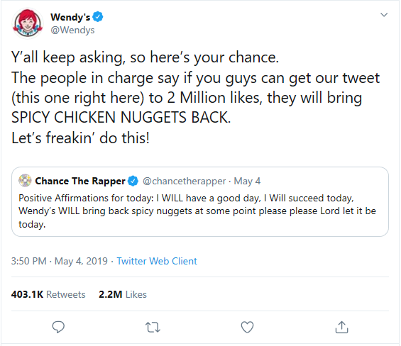
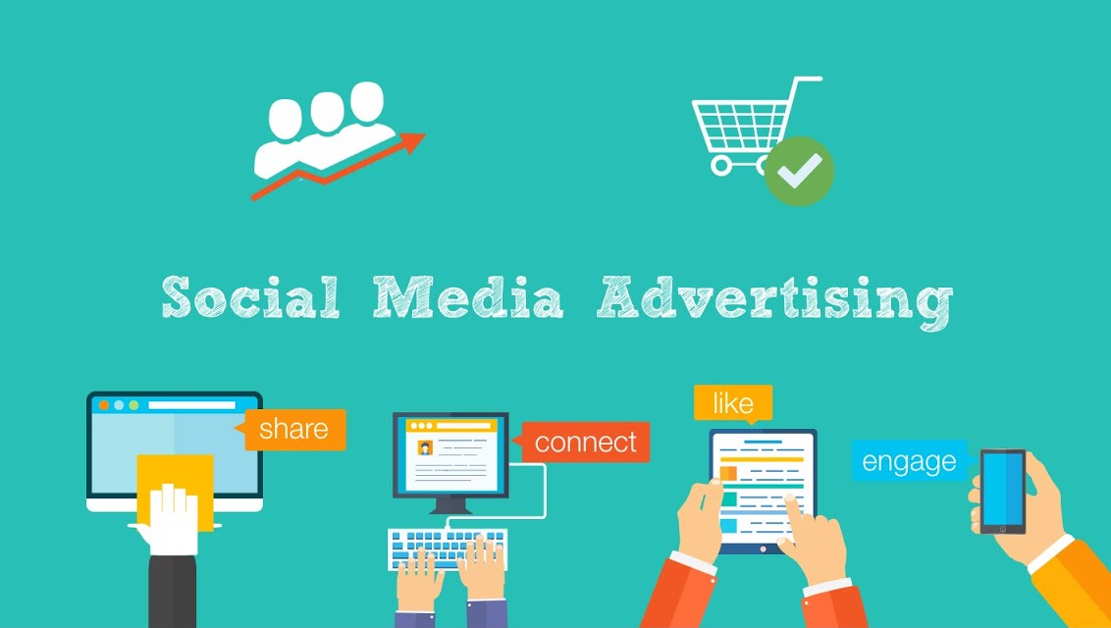
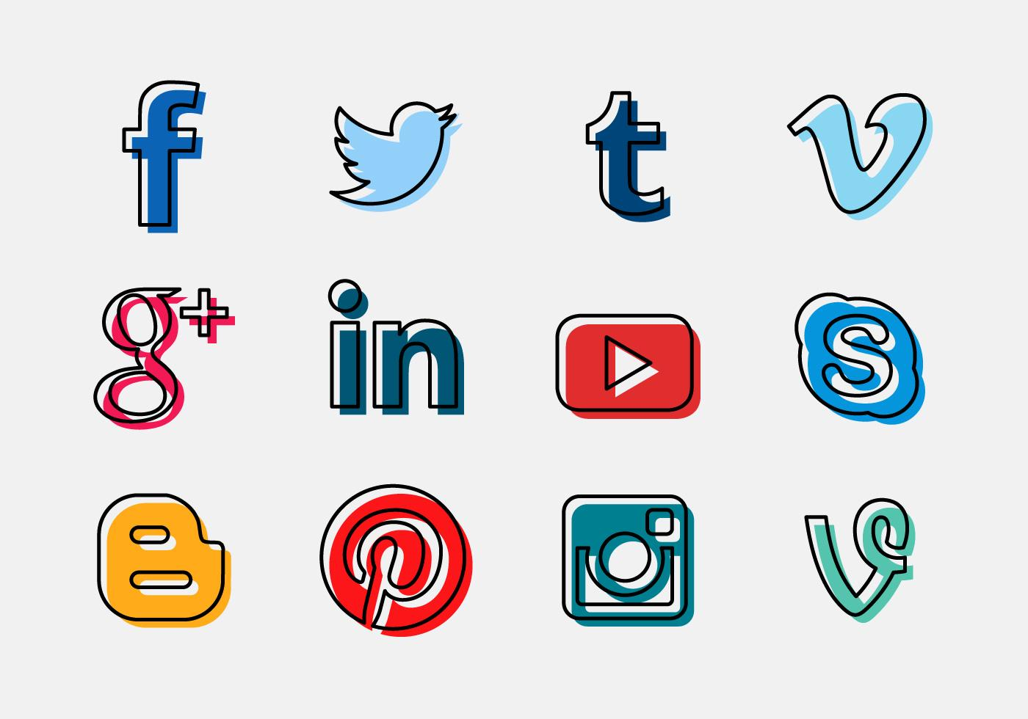
How Wendy’s used the Velocity of Social Media to Market their Product
Velocity
Wendy’s promoted their spicy chicken nuggets by to responding to a celebrity on twitter who had a pre-existing following.
1st Step
2nd Step
Wendy’s responded by telling the media that the company would bring the spicy nuggets back it they received 2 million likes on the tweet.
3rd Step
During and after Wendy’s made the challenge, the marketing team was 24/7 working to respond to regular twitter users to keep the velocity going up about the nuggets.
Why Companies should Use Social Media?
1. Connects you with potential costumers and target potential audience instantly.
Announced the release date of the nuggets. While promoting across all social media that they are coming back
4th Step
2. Brand Image thrives and build brand loyalty.
6
3. Competitors are already on Social Media
4. Free promoting a product or services.
Engage with your audience
5. Many Options to Promote
LIKES
5th Step
2.2 Million
Stay connected and up to date on product/services.

